Slide 1
Origami Tessellations Based Actuation
EGR557: Foldable Robotics
How can the directional stiffness exhibited by origami tessellations be used to simplify the actuation and locomotion of a laminate robot?
Bio-inspiration: ‘Rat’ Motion/Behaviour
-manufacturing constraints may necessitate a robot built at a slightly different scale
Team - Disha Vyas, Eric Feil, Manan Luthra,
Meet Shah, Dr. Dan Aukes (Advisor)
Project Update
Parameter ID & Dynamics II
Design Optimization & Validation
Final Prototype
Conclusions

Slide 2
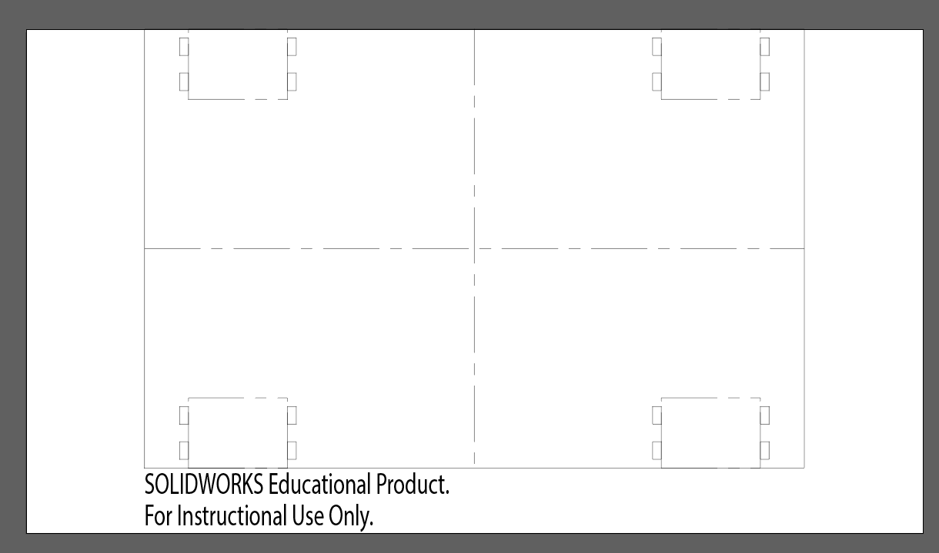
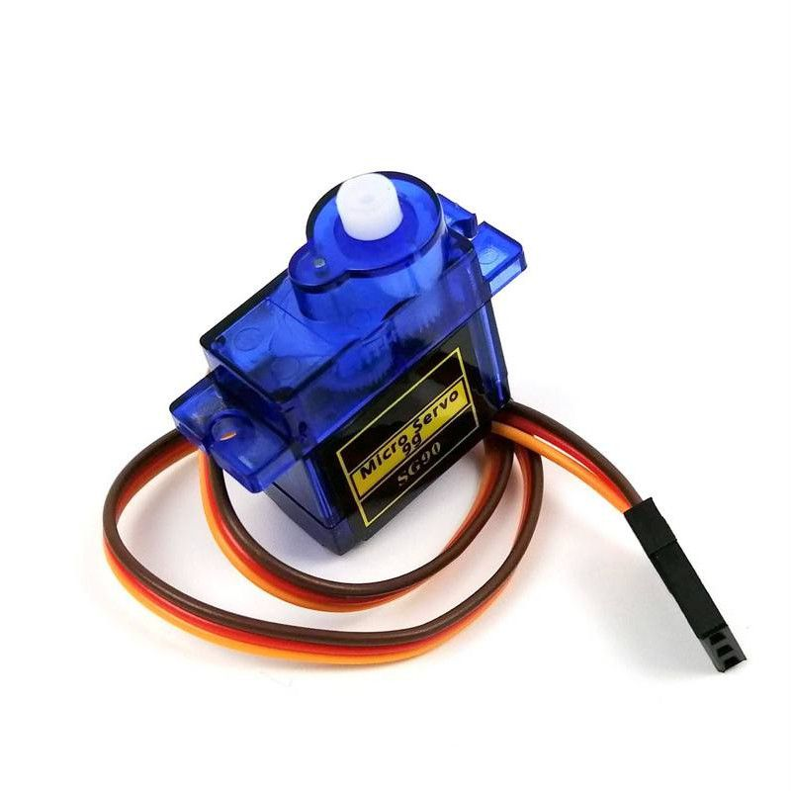
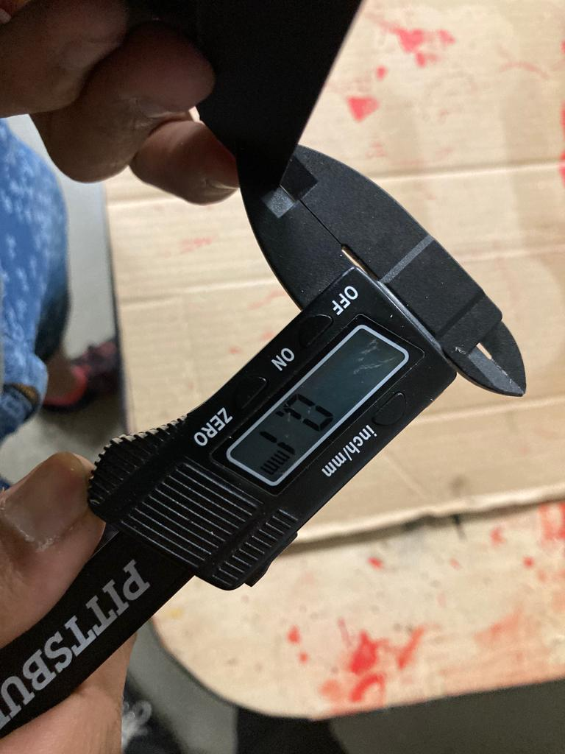
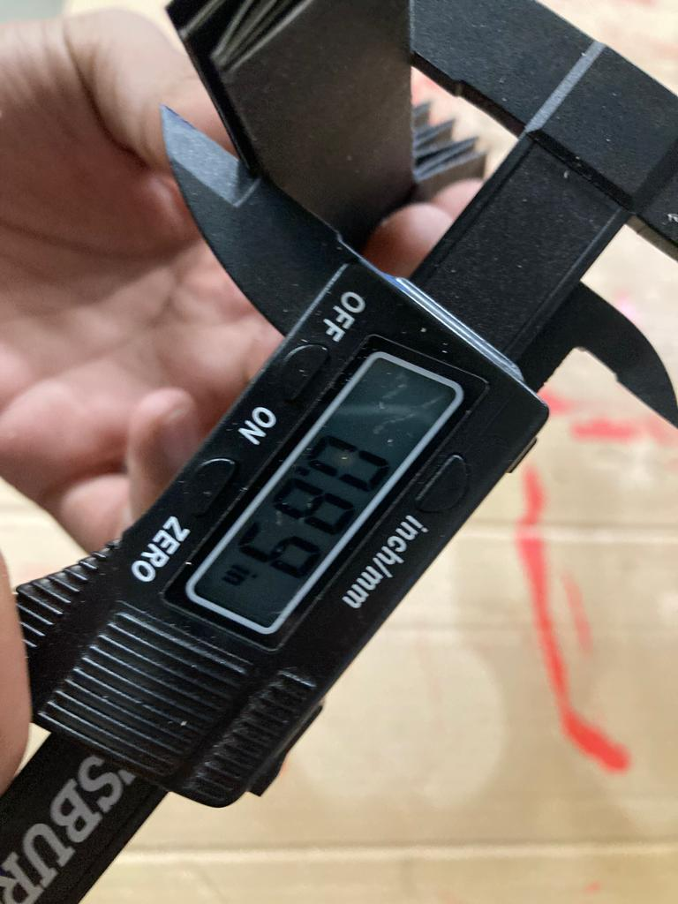
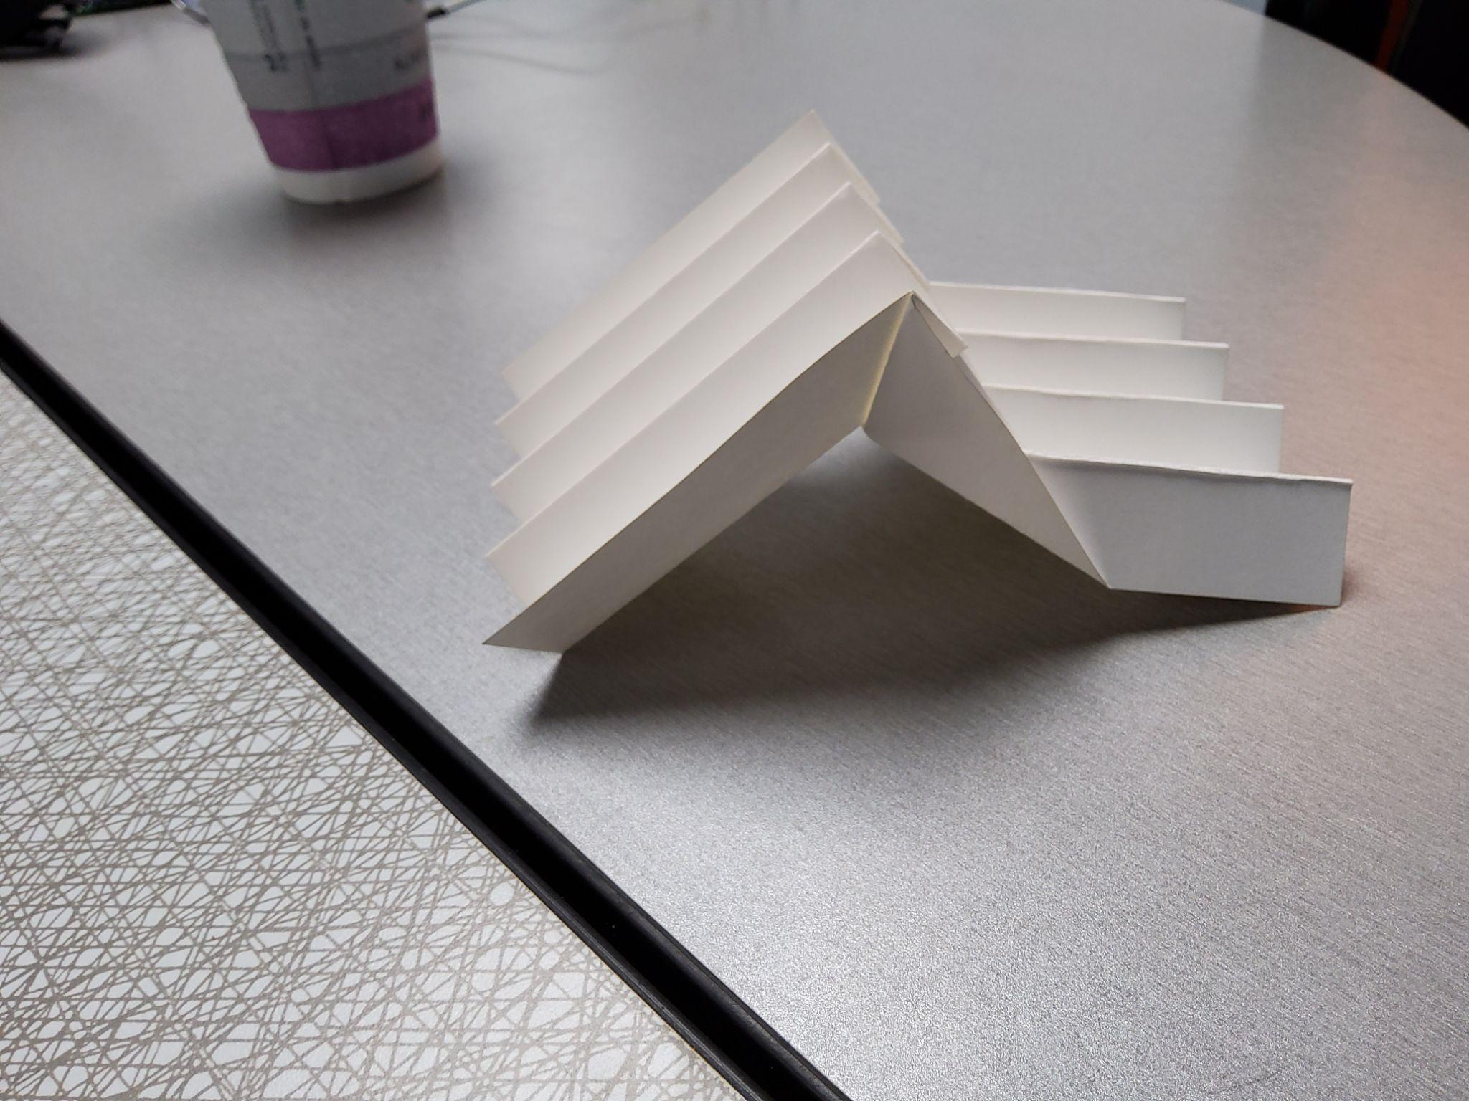
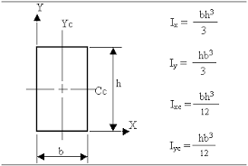
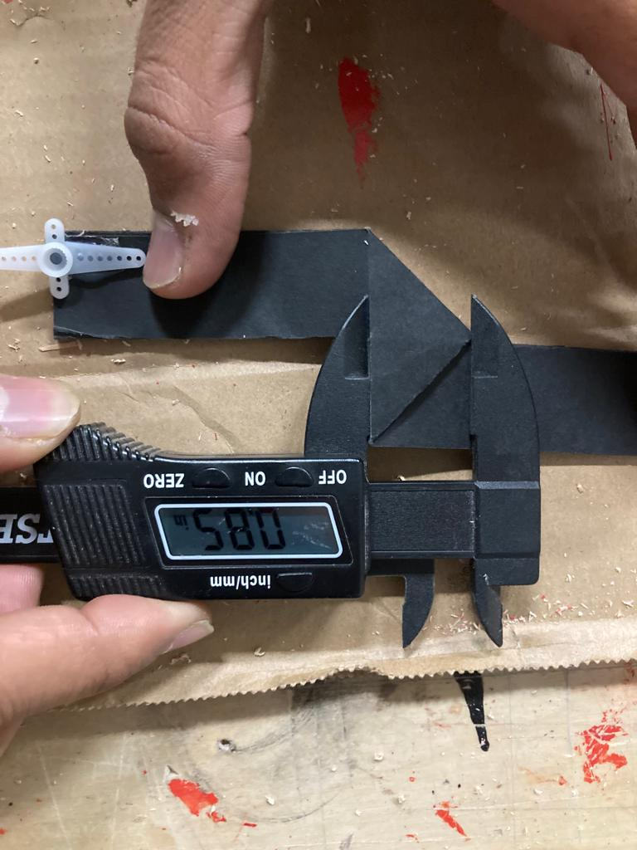
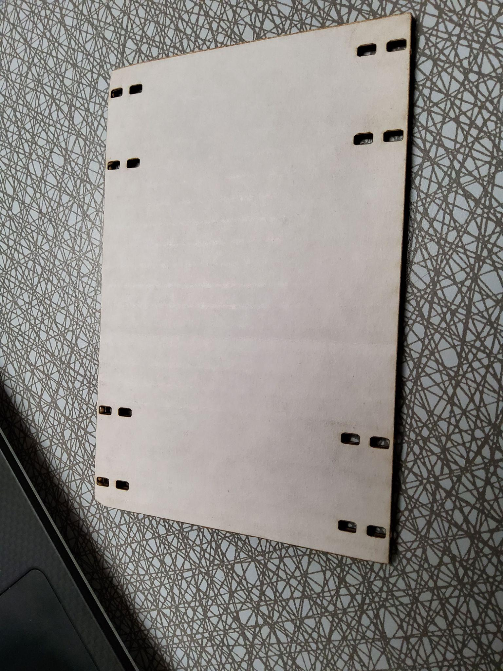
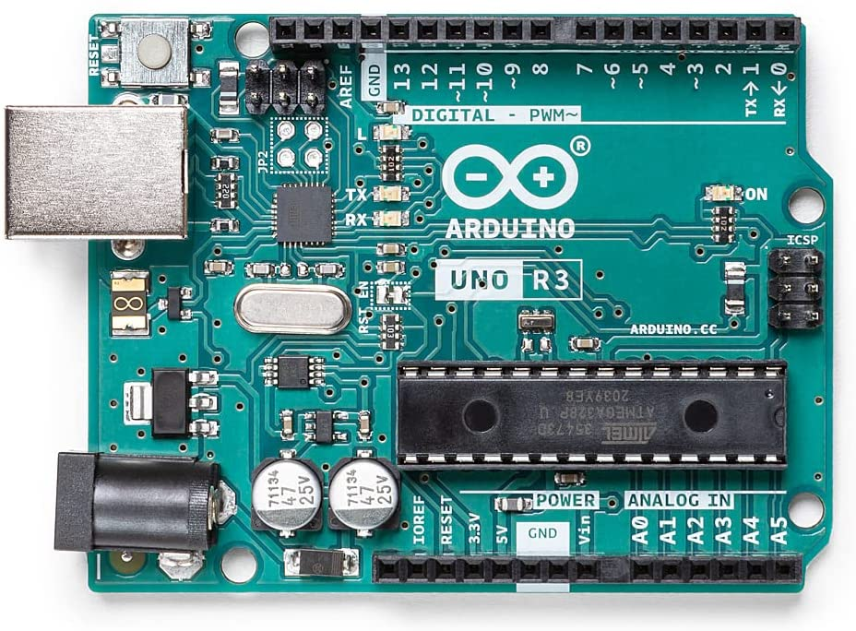
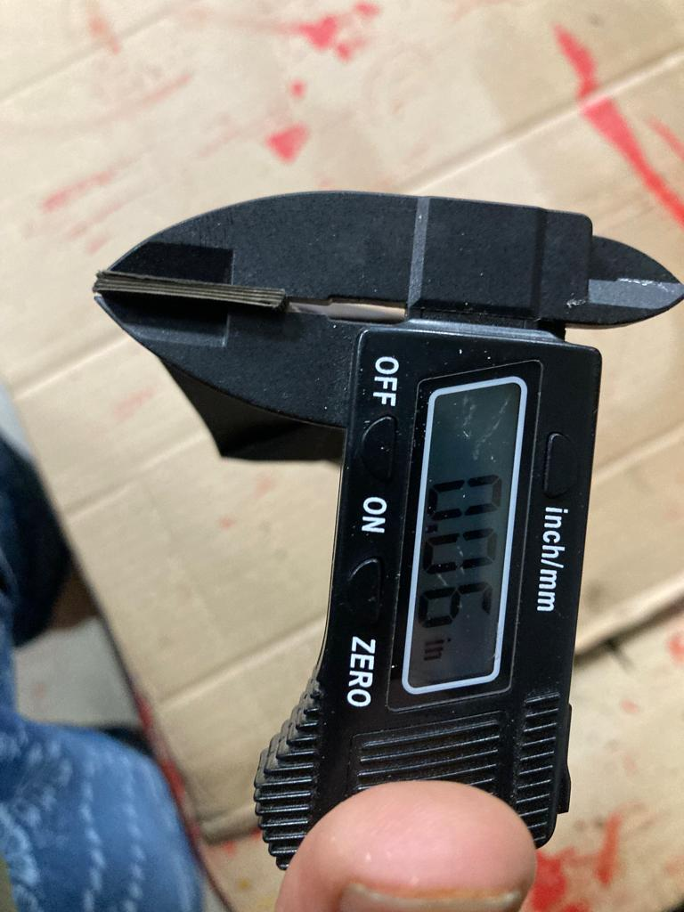
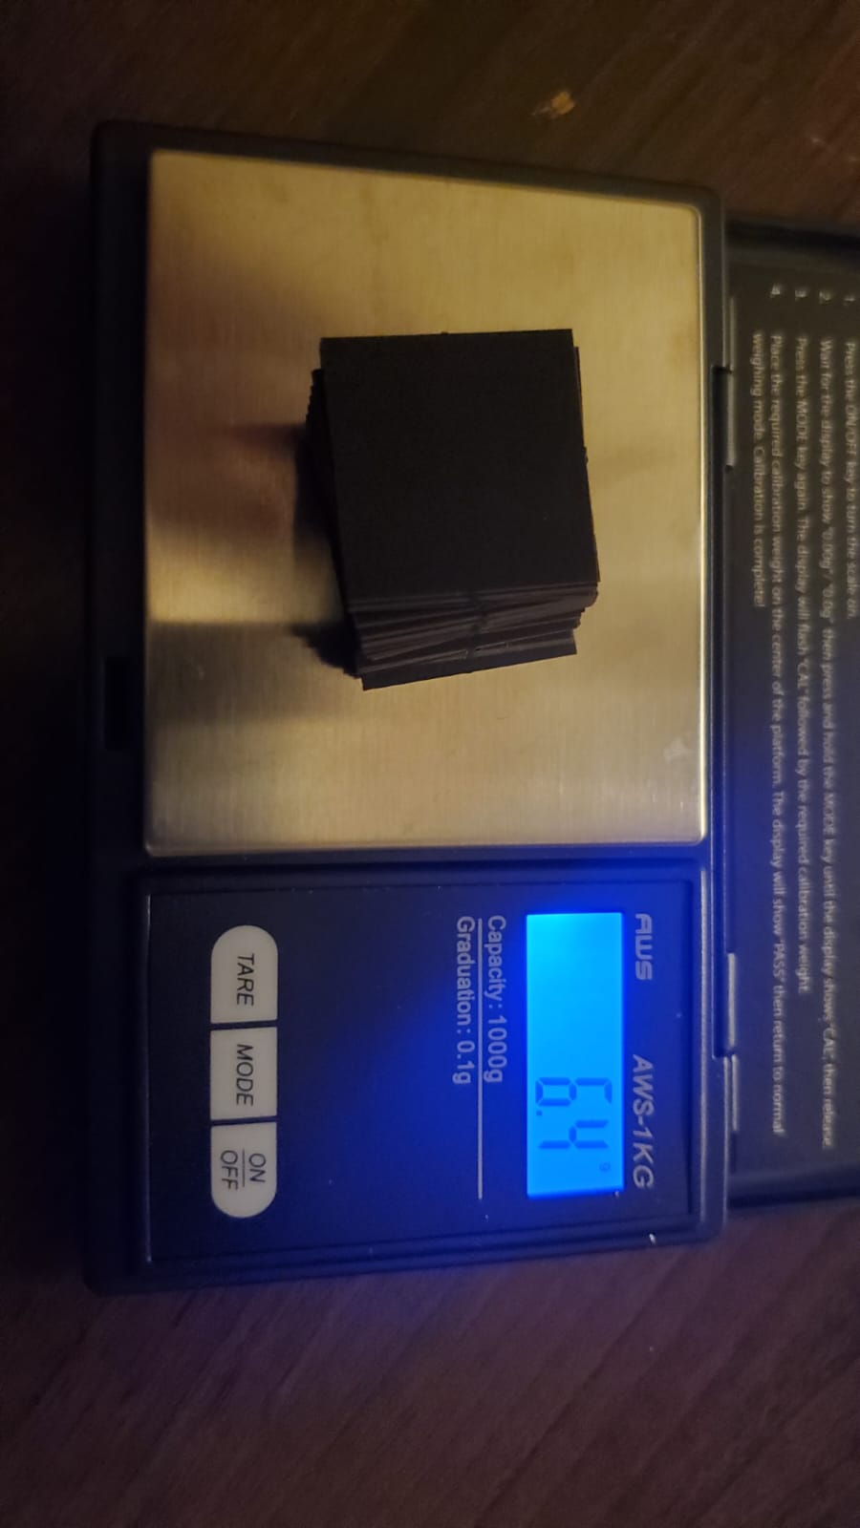
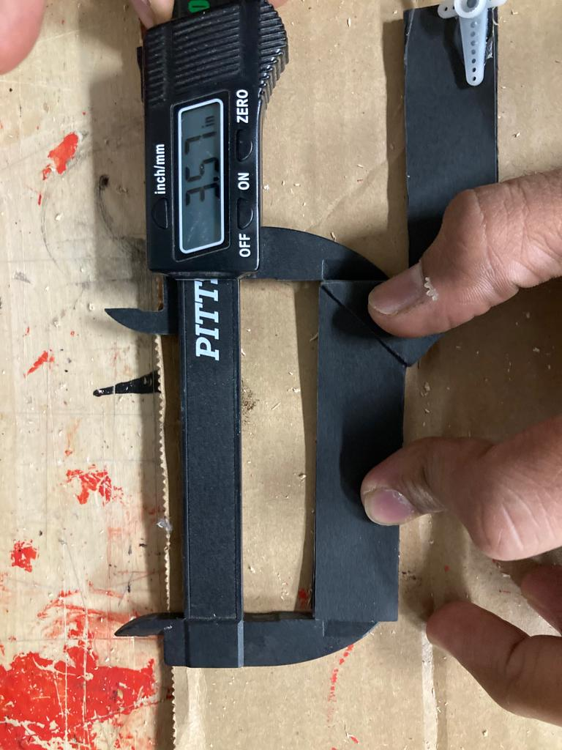
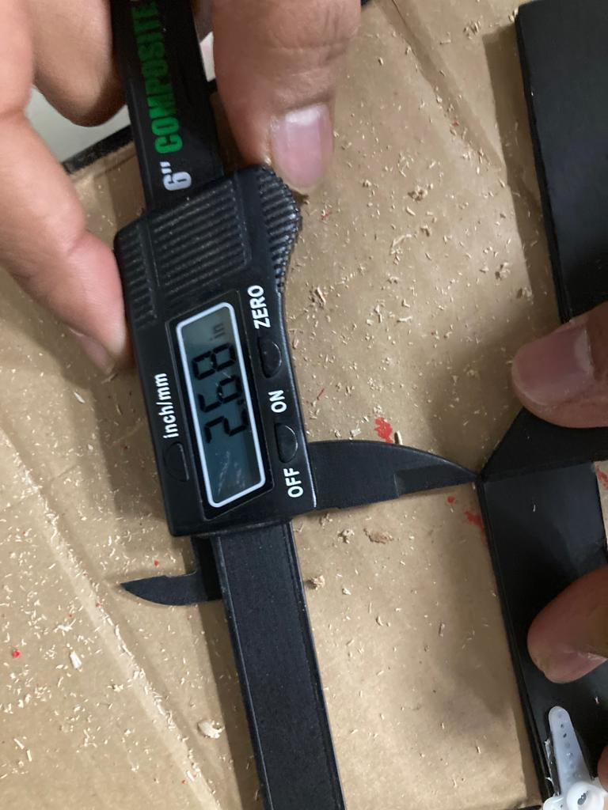
Materials:
0.1 mm Thickness paper
0.14” Thickness Cardboard
SG90 Mini Servo Motors
5V power adaptor
Arduino Processor
Parameter ID
Mass and Inertia Properties:
Each leg:
2.5 gram weight
0.06” Thickness
7.48inch total length
Project Update
Parameter ID & Dynamics II
Design Optimization & Validation
Final Prototype
Conclusions

Slide 3
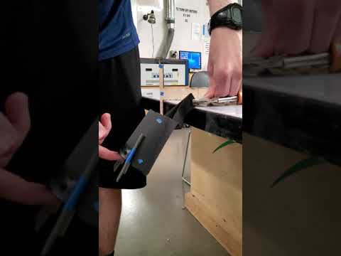
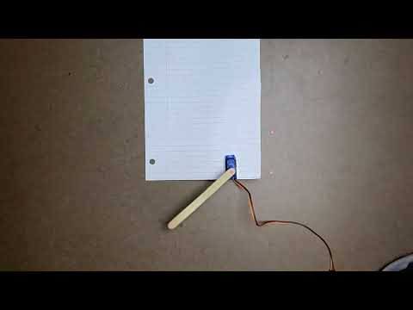
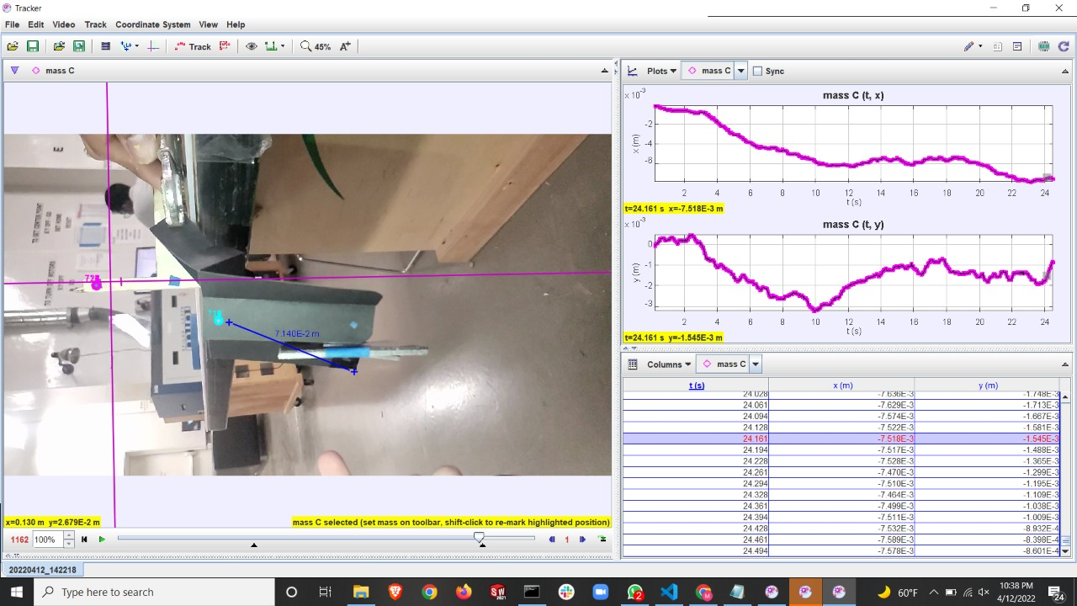
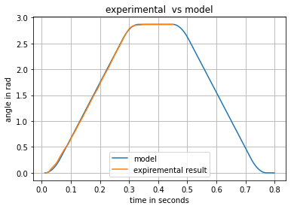
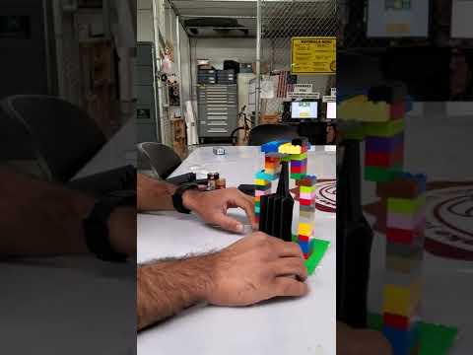
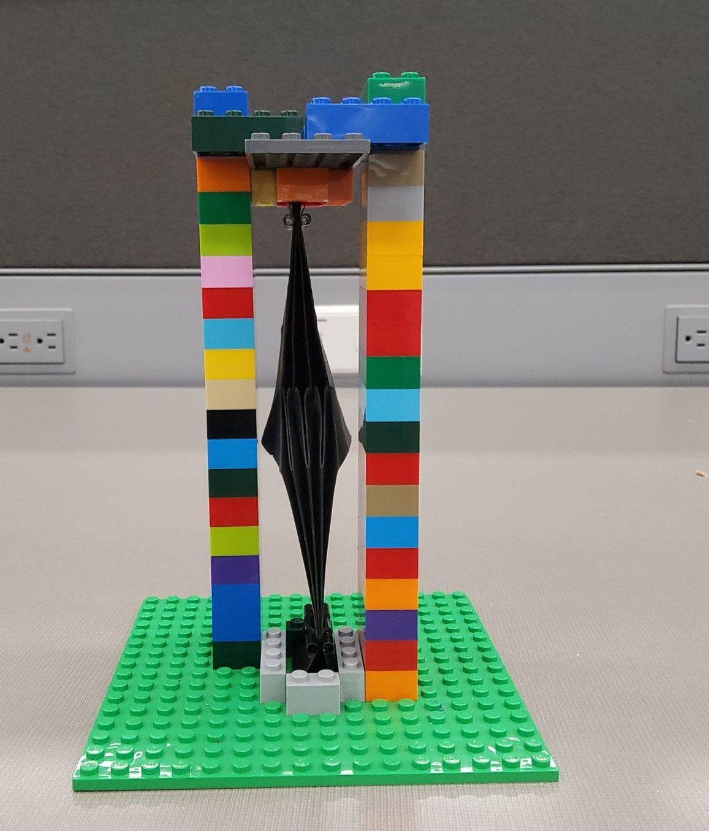
Parameter ID
Low Rotational
Inertia Test
Leg Damping
Buckling Test

Slide 4
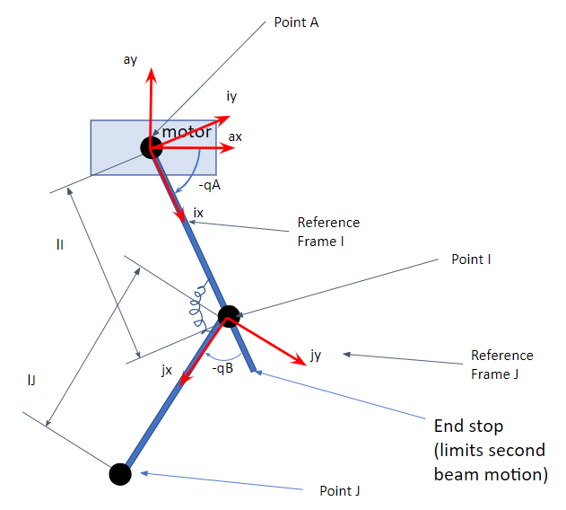
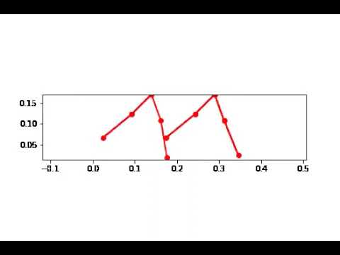
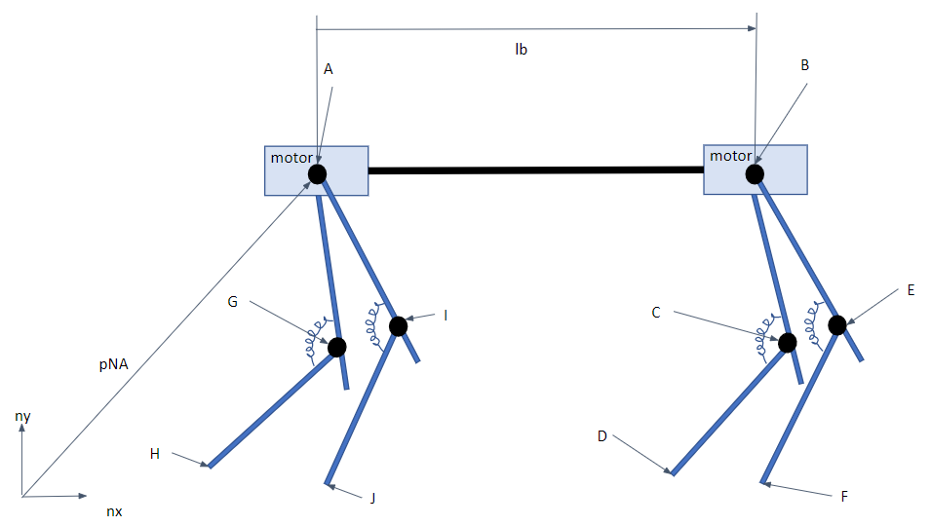
Dynamics II
Animation for System Dynamics
Animation for System Dynamics
Coordinate Representation for a leg in Robot
System Dynamics Representation for Robot
Project Update
Parameter ID & Dynamics II
Design Optimization & Validation
Final Prototype
Conclusions

Slide 5
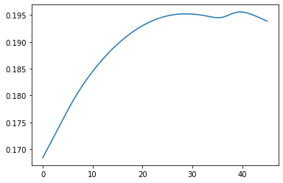
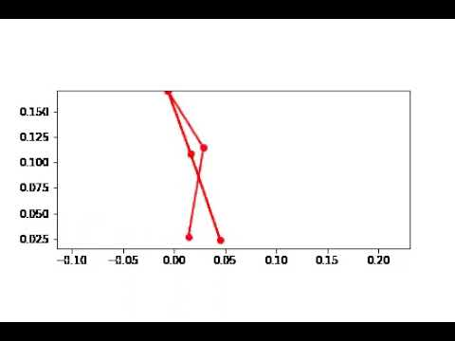
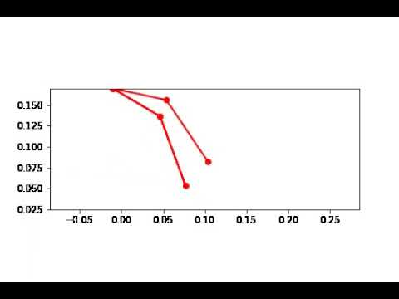
Design Optimization
Simulation with End stop angle: 0
Performance
Simulation with End stop angle: 39.5
End Stop Angle
The optimum end stop angle was determined to be 39.5 degrees.
Project Update
Parameter ID & Dynamics II
Design Optimization & Validation
Final Prototype
Conclusions

Slide 6
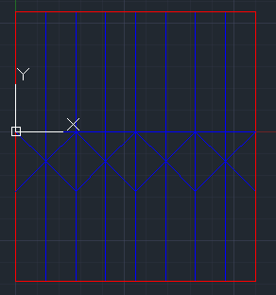
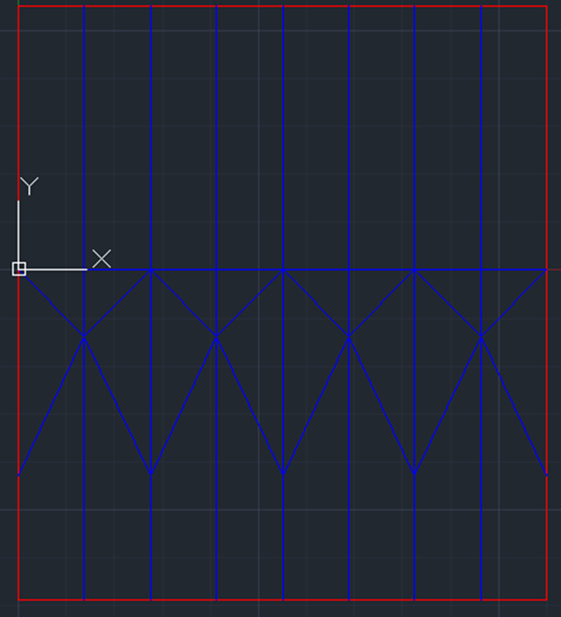
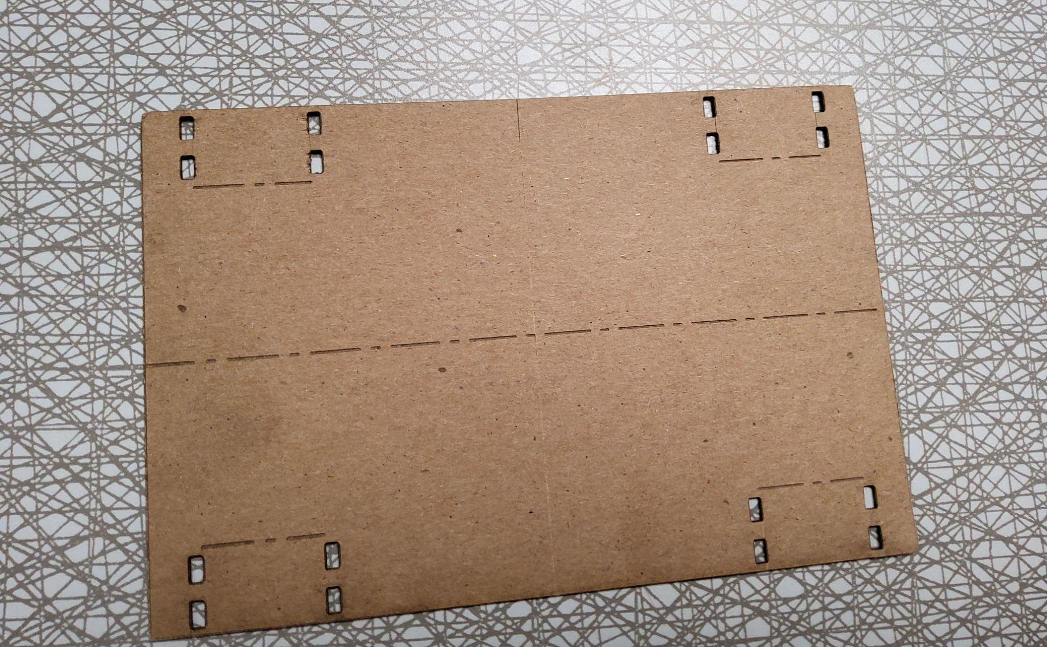
Single Layer Design:
Blue lines are etched by laser causing the cardstock to fold easily along them
Red lines are cuts made by the laser cutter

Slide 7
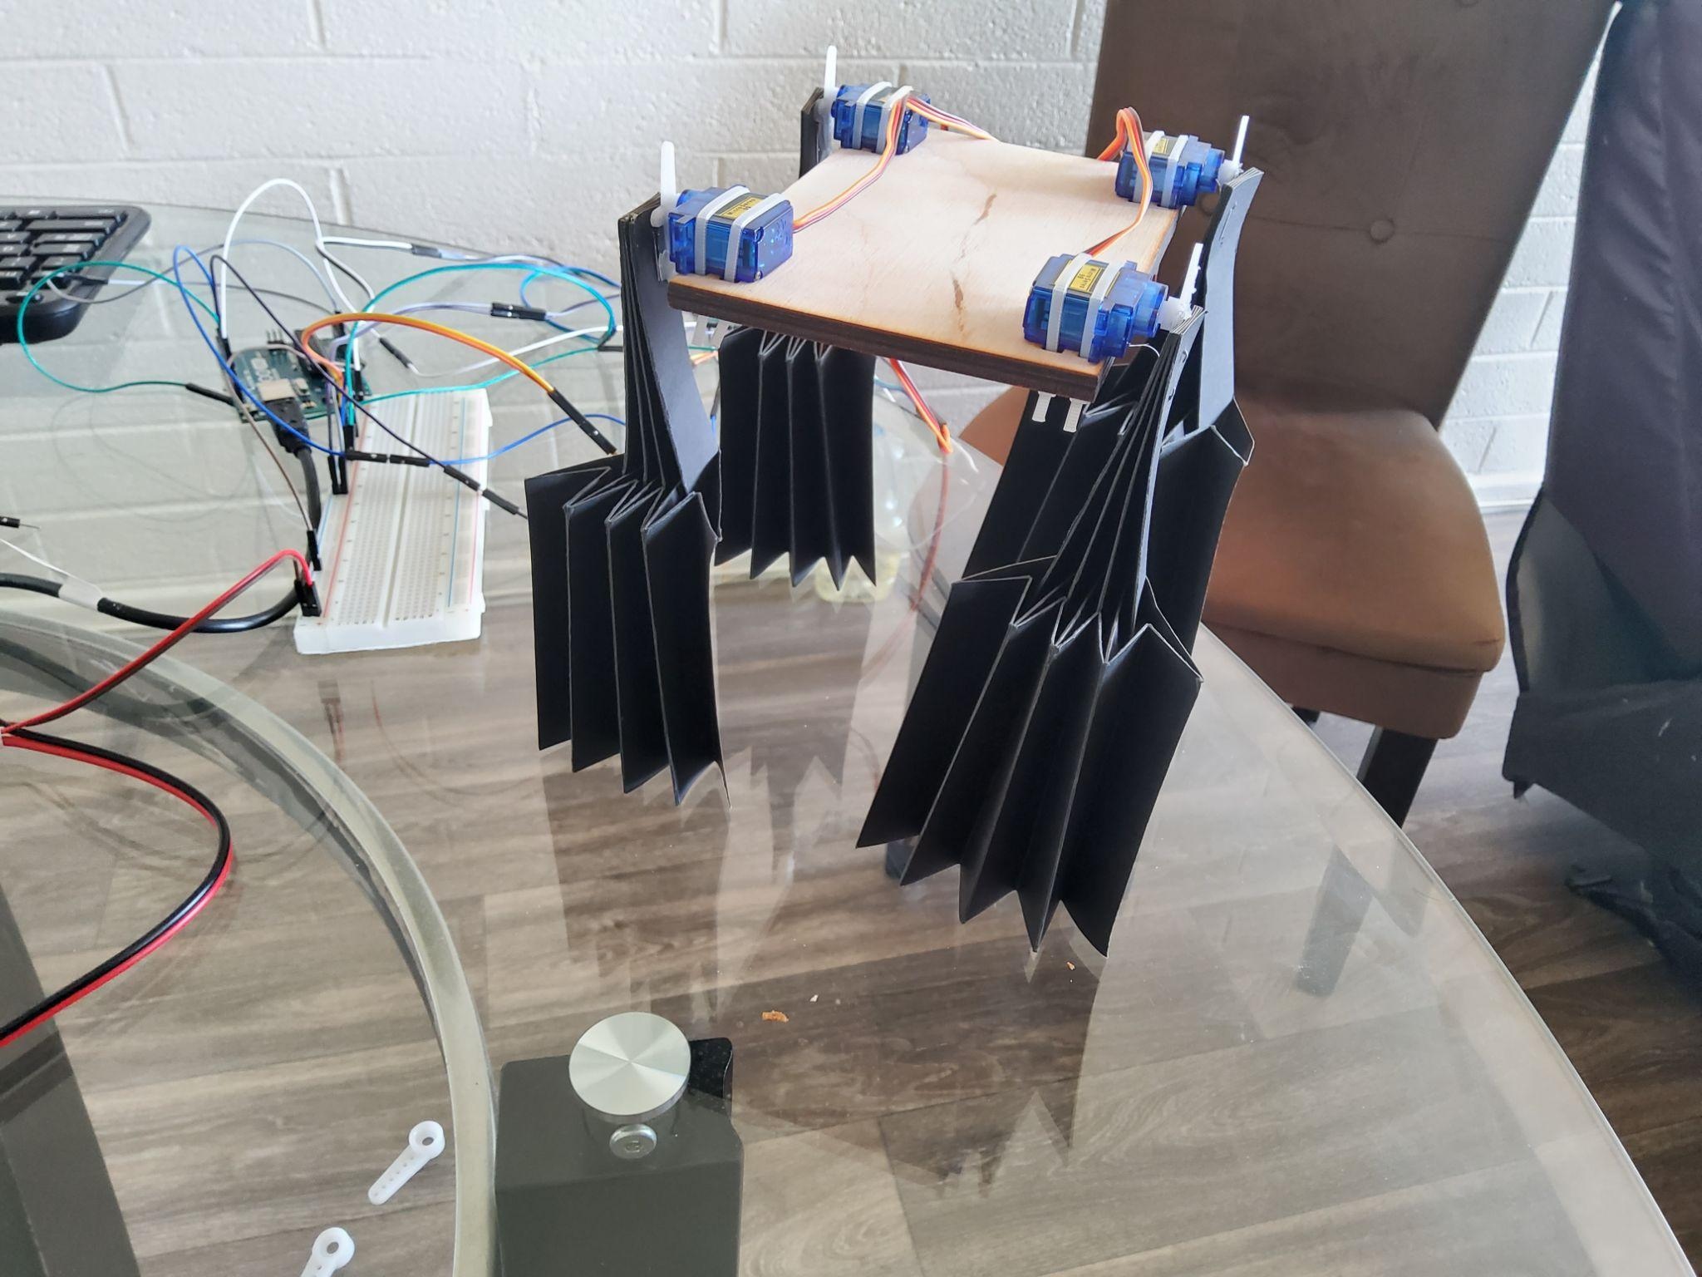
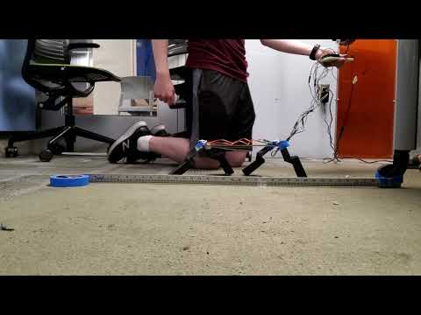
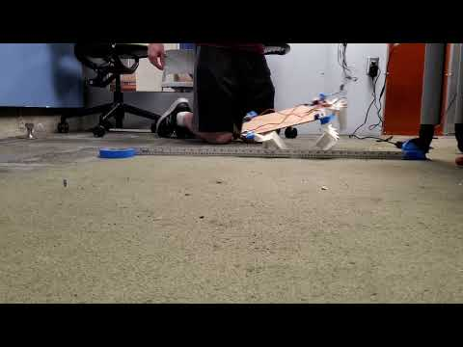
Final Prototype

Slide 8
Conclusion
Advantages:
Overcomes the challenge of coordination and rely on fewer individual sub-units
Lightweight, compact, and scalable while maintaining its kinematic behavior
Flexible and Inexpensive
Only one motor is needed per limb
Drawbacks:
Stability (This drawback might get solved if we use 3 pair of legs)
Impact:
Provokes creativity amongst the research community
Motivate roboticists to design complex mechanical systems with movements that can be controlled by a single motor
Remaining research:
Develop specific strategies to improve the prototype design
Develop better dynamic simulation of robot
Project Update
Parameter ID & Dynamics II
Design Optimization & Validation
Final Prototype
Conclusion

Slide 9
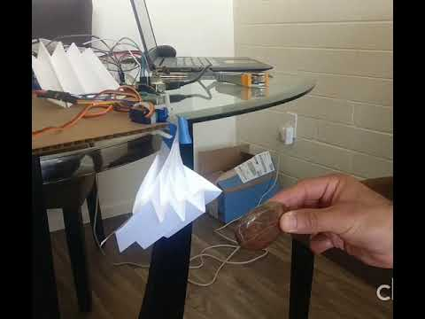
Future Plans
Potential application in space exploration because of light weight structure
Efficient travel on multiple terrains
Possible locomotion under water

Slide 10
References
[1] D. Aukes, “Foldable Robotics Github Repository”, https://foldable-robotics.github.io/
[2] A. J. Parker and K. A. Clarke, “Gait topography in rat locomotion,” Physiology & Behavior, 14-Feb-2003. [Online]. Available: https://www.sciencedirect.com/science/article/abs/pii/0031938490902586. [Accessed: 12-Feb-2022].
[3] C. S. Howard, D. C. Blakeney, J. Medige, O. J. Moy, and C. A. Peimer, “Functional assessment in the rat by ground reaction forces,” Journal of Biomechanics, vol. 33, no. 6, pp. 751–757, 2000.
[4] Dvm, Artur & Md, Phd & Md, Phd & Bulas-Cruz, José & Filipe, Vítor & Melo-Pinto, Pedro & Varejão, Artur & Cabrita, António & Meek, Marcel & Bulas‐Cruz, José & Gabriel, Ronaldo & Melo‐Pinto, Pedro & Winter, David, “Motion of the foot and ankle during the stance phase in rats”, Muscle & Nerve, 2002, vol. 26, pp. 630 - 635, doi: 10.1002/mus.10242.
[5] S. Wang et al., "Design and Control of a Miniature Quadruped Rat-inspired Robot," 2019 IEEE/ASME International Conference on Advanced Intelligent Mechatronics (AIM), 2019, pp. 346-351, doi: 10.1109/AIM.2019.8868662.
[6] Lucas, Peer., “Design of a Biomimetic Rodent Robot”, 2019, doi: 10.14459/2018md1464578.

